Slide 1
Dimensionality Reduction
Noble Xavier

Slide 2

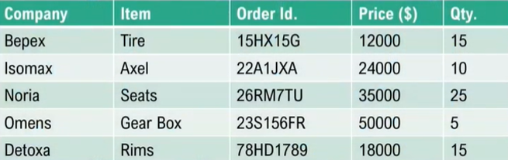

Slide 3
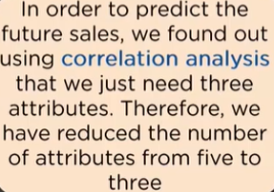
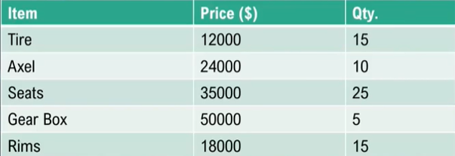

Slide 4

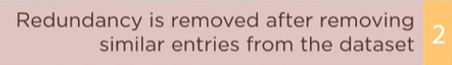





Slide 5
PRINCIPAL COMPONENT ANALYSIS (PCA)

Slide 6
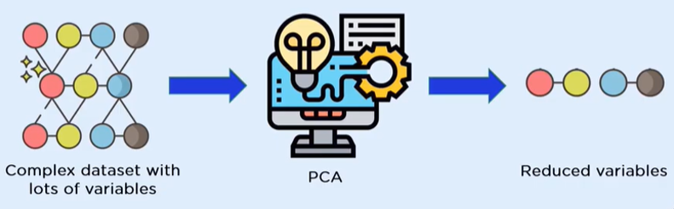

Slide 7
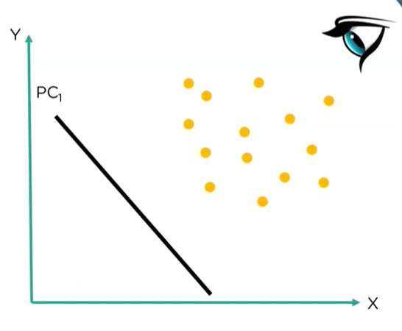
In PCA find the best projection of the Data Points

Slide 8
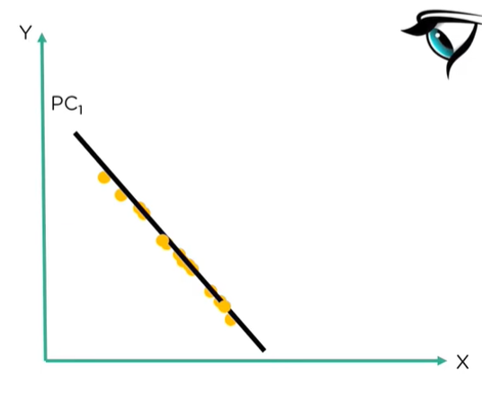
In PCA find the best projection of the Data Points

Slide 9
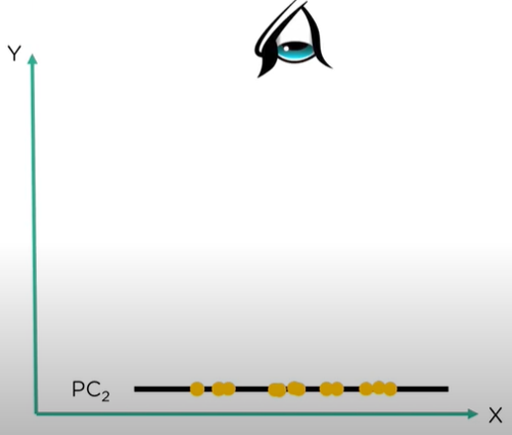
In PCA find the best projection of the Data Points

Slide 10
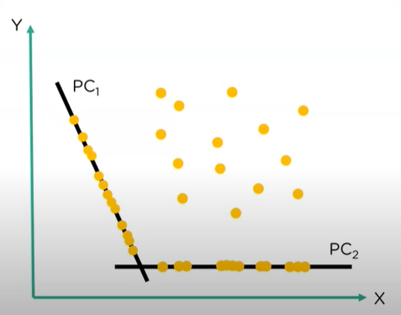


Slide 11

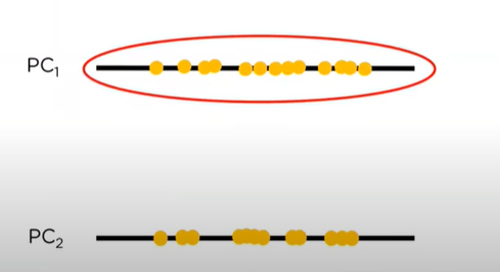

Slide 12
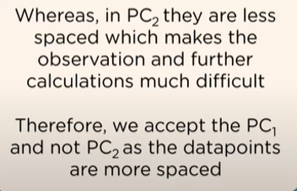
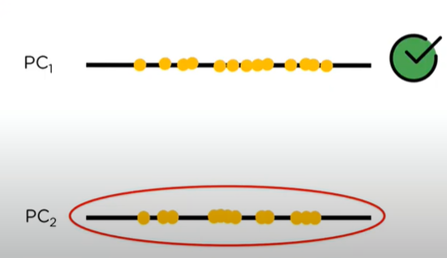

Slide 13









Slide 14
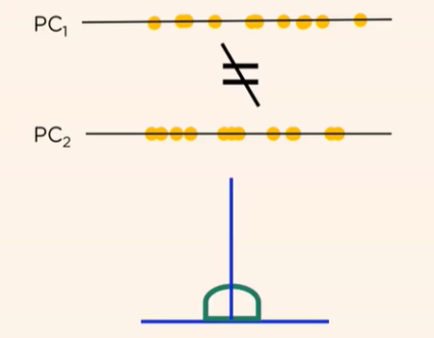
The number of Principal components is always less than or equal to the number of attributes
Principal Components are orthogonal

Slide 15
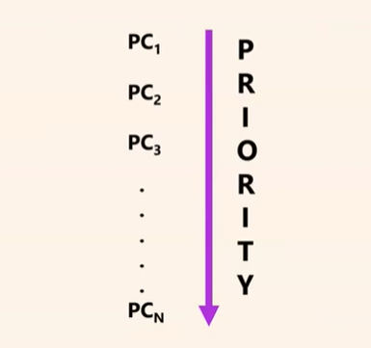
The priority of principal components decreases as their numbers increase

Slide 16
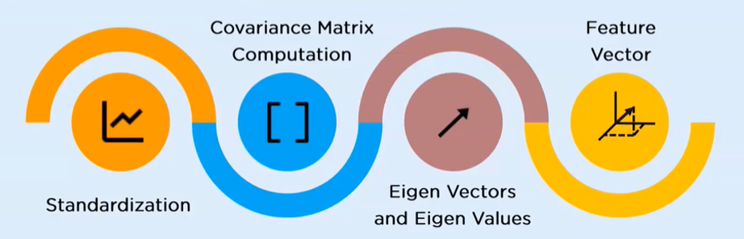

Slide 17


Slide 18

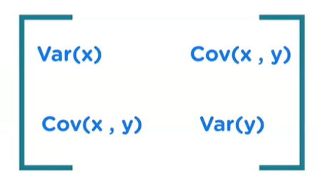

Slide 19

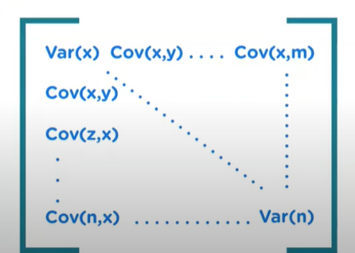

Slide 20
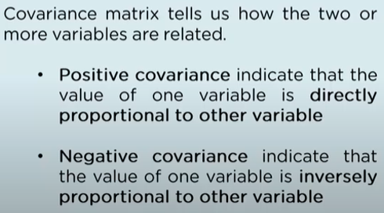
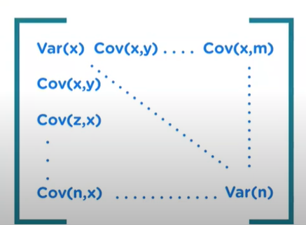

Slide 21
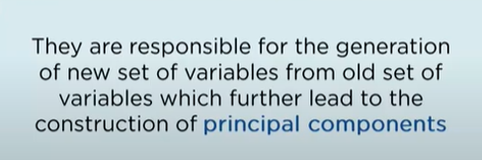
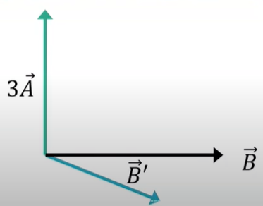

Slide 22
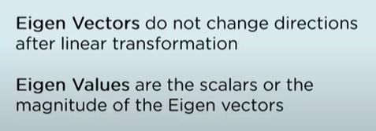
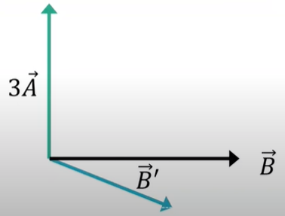

Slide 23

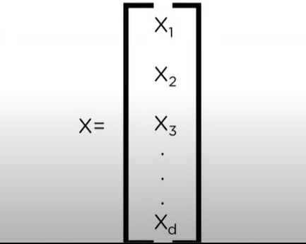

Slide 24
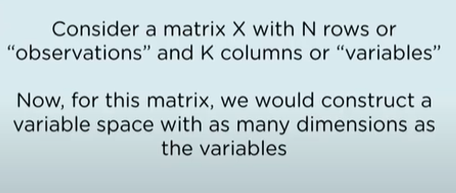
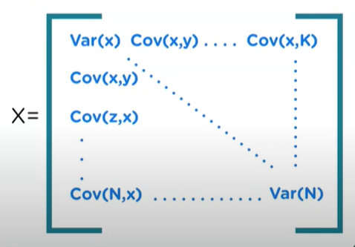

Slide 25

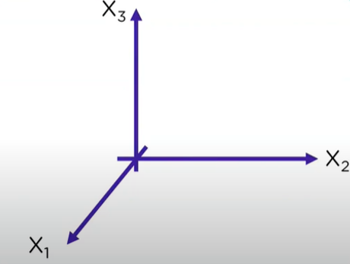

Slide 26
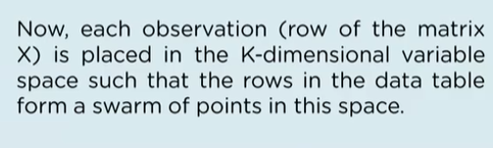
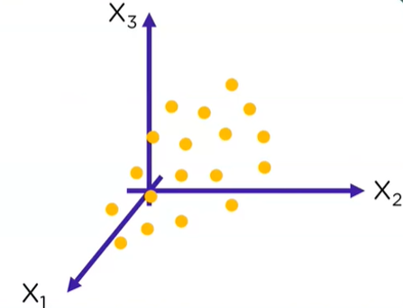

Slide 27
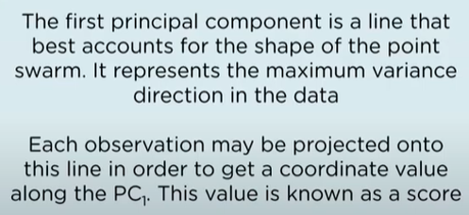
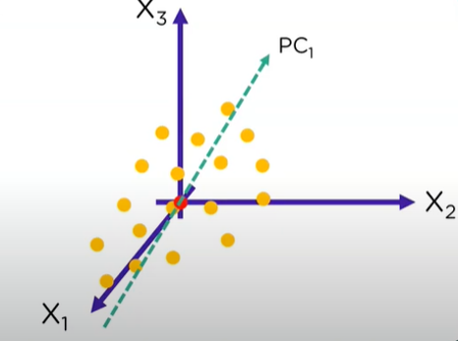

Slide 28
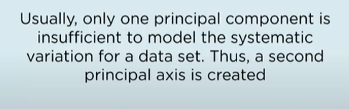
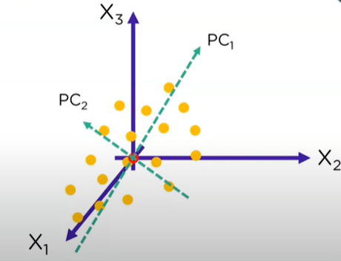

Slide 29

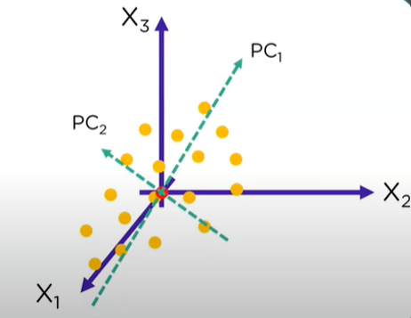

Slide 30
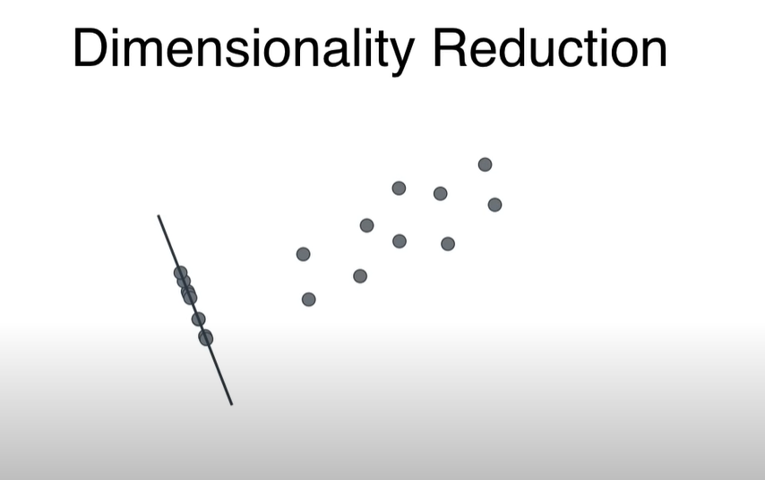

Slide 31
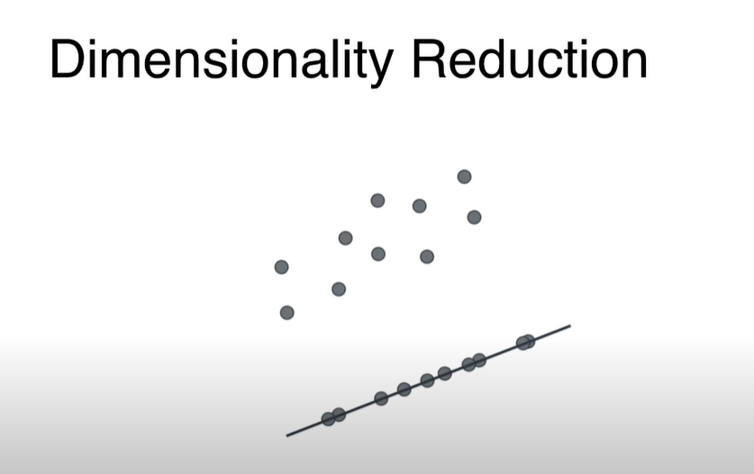
Project the Data to another straight Line

Slide 32
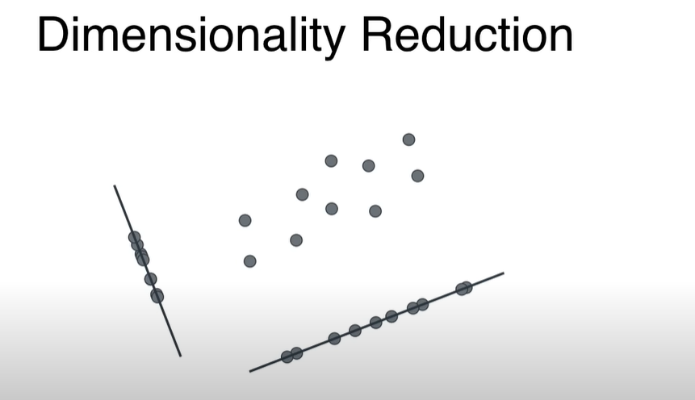
Which Line is better

Slide 33
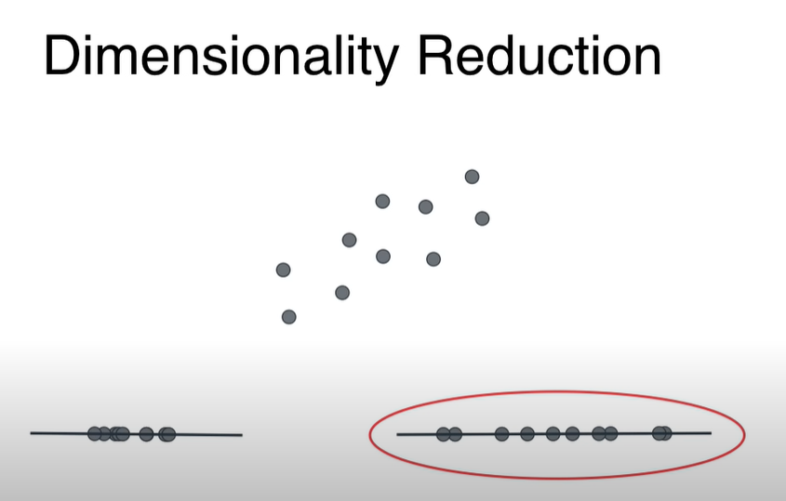
Right side line is better, since data is more spread here

Slide 34
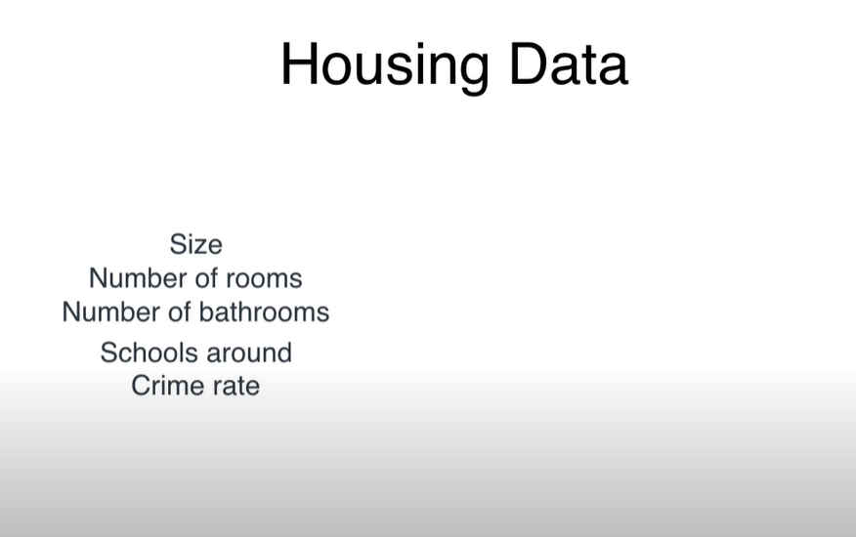

Slide 35
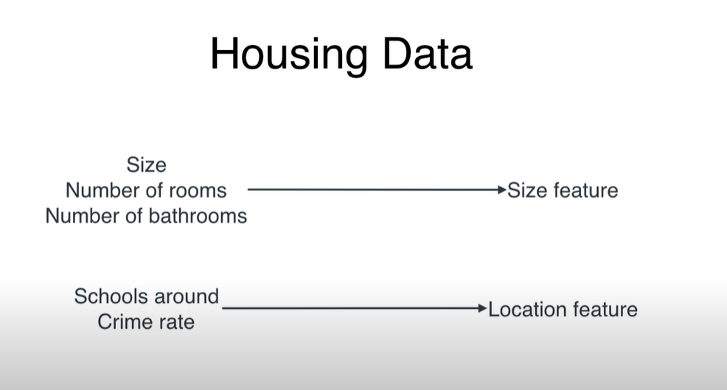

Slide 36
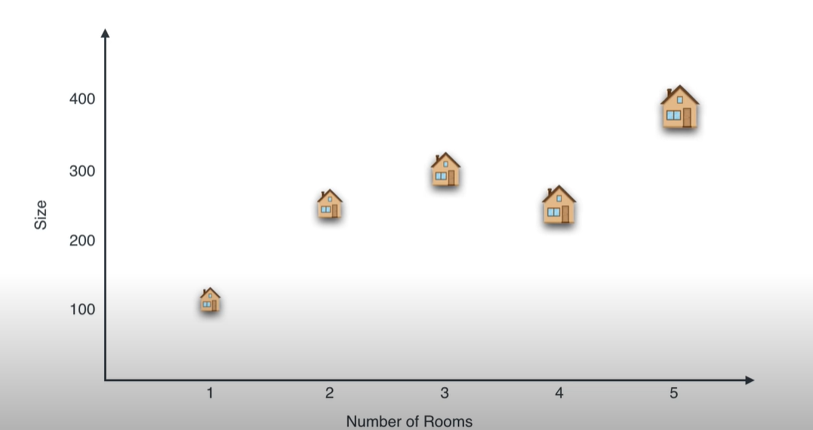

Slide 37
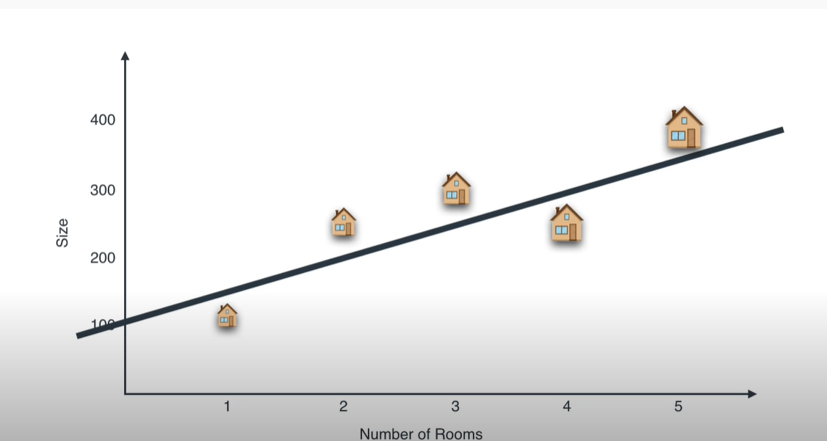
The straight created below is the line with Best projection

Slide 38
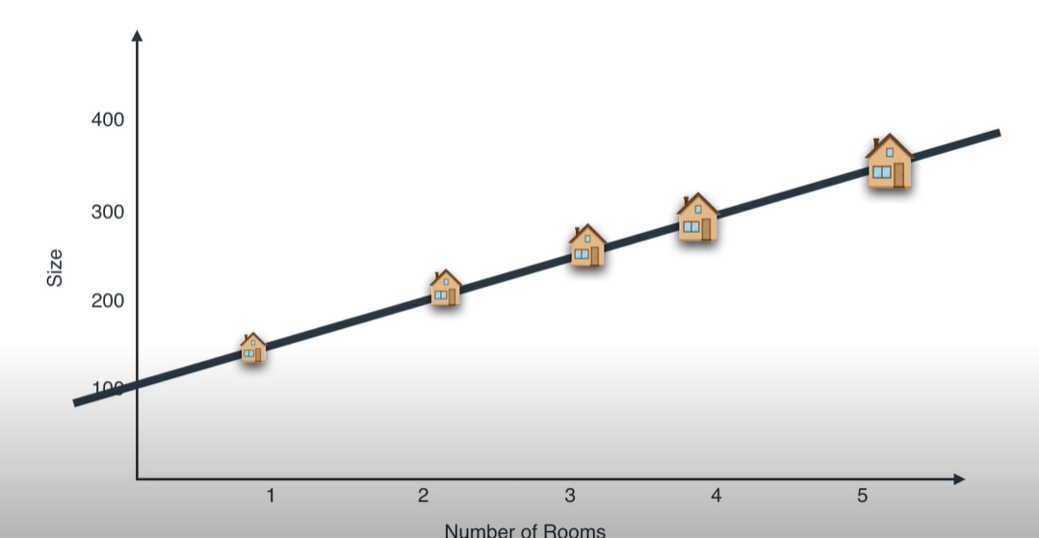
Project each house to straight line

Slide 39
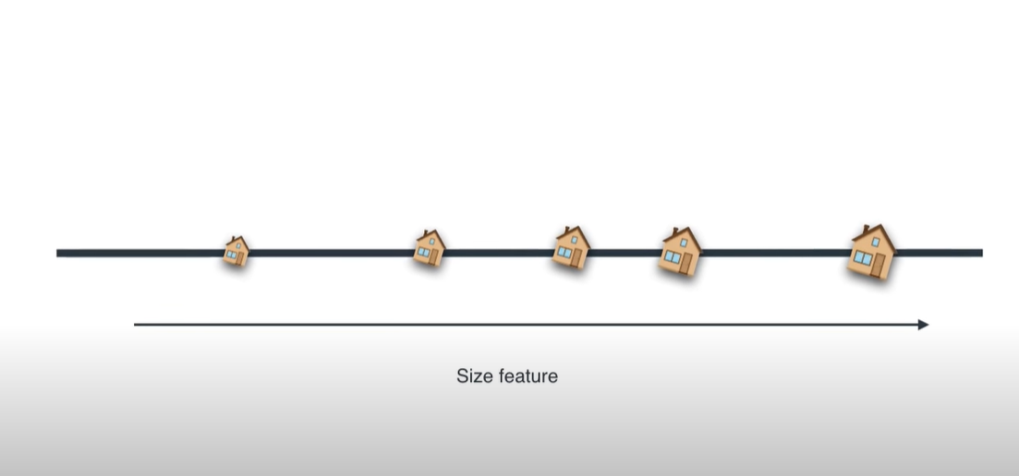
Since the data is one dimensional Rotate the line as mentioned below

Slide 40
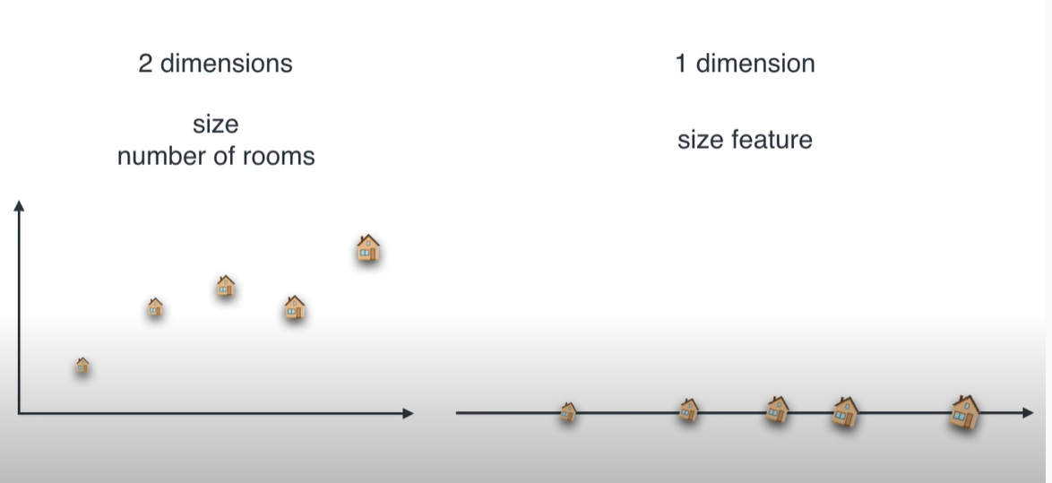
Now the Data become more simpler

Slide 41
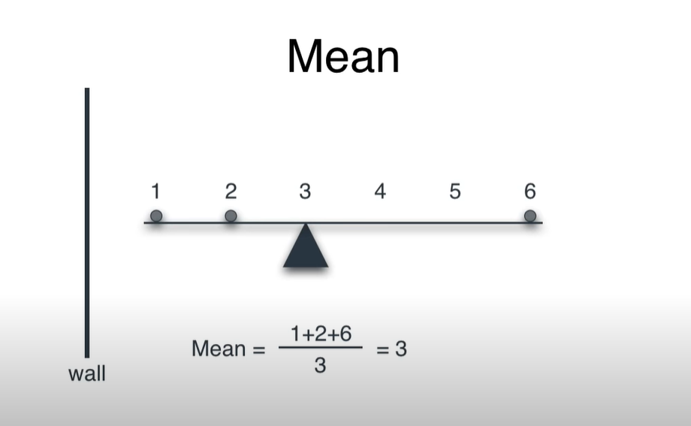
Mean of Three Points

Slide 42
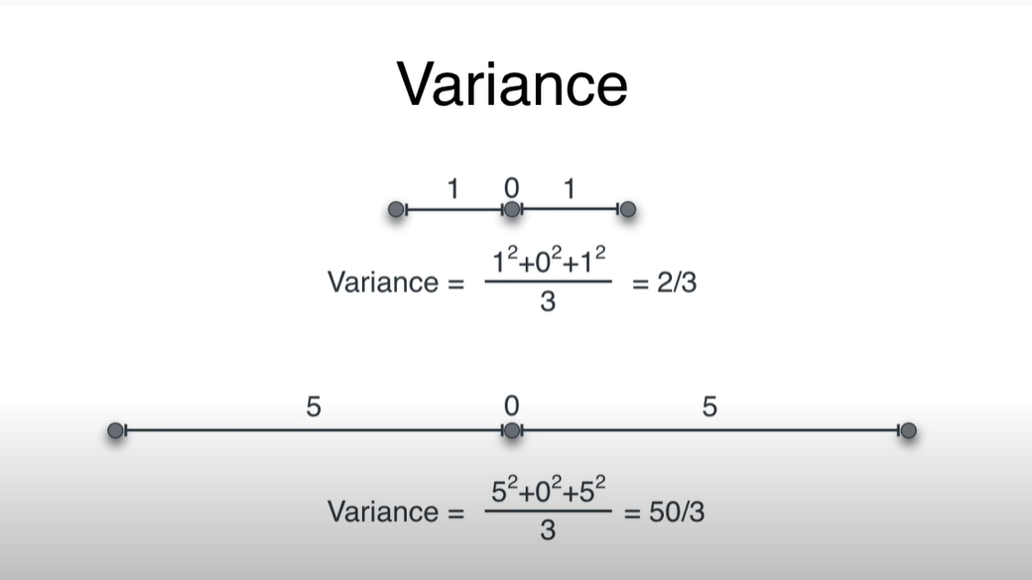

Slide 43
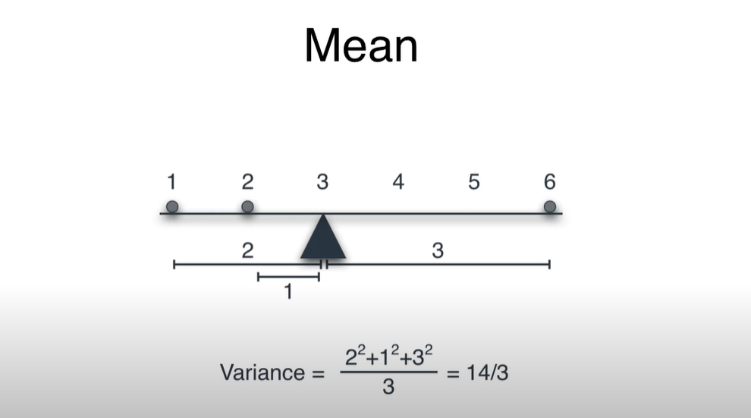
Mean Variance of Three Points

Slide 44
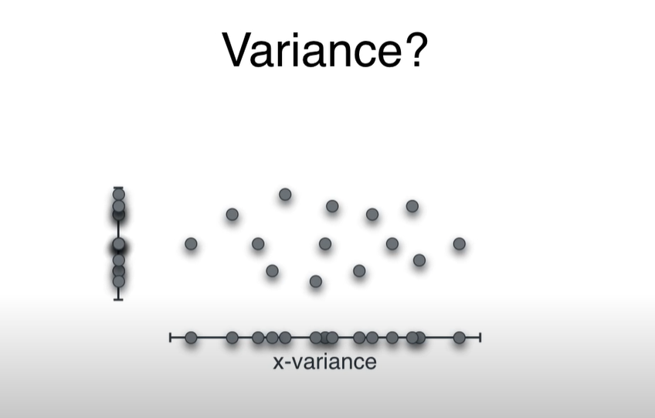
Variance of 2D Data
Project the Data to X –Axis gives X- Variance and Project the Data to Y axis gives Y-Variance
as mentioned below

Slide 45
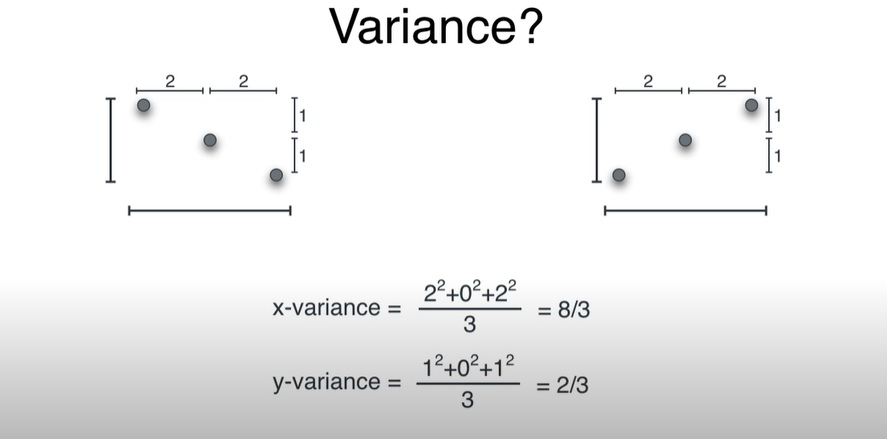
The Above data set has same X-Variance and Y –Variance. Even though the data is different.

Slide 46


This is case Covariance tells how both the set of data are different

Slide 47


Slide 48

The points on left side are negatively co related ie X – increases , Y –Decreases
The points of right side are positively co related ie X – increases , Y –Increases

Slide 49


Covariance of above data set: Sum of product of co-ordinates/
Total number of Points

Slide 50


Slide 51

Steps to Implement PCA
1. Specify the co –ordinates as mentioned below

Slide 52

Steps to Implement PCA
2. Centre the Data Points : Average of co –ordinates in the X and Y Direction

Slide 53

Var(X) : Variance in the horizontal axis – X – Axis
Var(Y) : Variance in the vertical axis - Y– Axis
Cov(X,Y) : This need to place two times

Slide 54

Populate Covariance Matrix , These Values might not be very accurate. As per the data X- Variance is more and Y-Variance is less. The covariance looks positive, Since it is an increase in trend

Slide 55


Slide 56


Slide 57


Slide 58


Slide 59


Slide 60


Slide 61


Slide 62


Slide 63


Slide 64


Slide 65


Slide 66


Slide 67


Slide 68


Slide 69

Since there are two Eigen values consider the one with Maximum Value and project all the data to the line which is related to the highest Eigen Value.

Slide 70


Slide 71

There are five Eigen Values and five Eigen Vectors, from this need to consider, how many Eigen Values and Eigen vectors needs to consider to create PCA .
Example we are taking only two
Eigen Values and Eigen vectors

Slide 72

Considering two Eigen Values and Eigen Vectors, project all the data to two lines.

Slide 73


Slide 74
PCA EXAMPLE -2

Slide 75


Slide 76



Slide 77


Slide 78


Slide 79


Slide 80


Slide 81


Slide 82


Slide 83


Slide 84


Slide 85


Slide 86


Slide 87


Slide 88


Slide 89


Slide 90


Slide 91


Slide 92


Slide 93


Slide 94


Slide 95


Slide 96


Slide 97


Slide 98


Slide 99


Slide 100


Slide 101


Slide 102


Slide 103


Slide 104


Slide 105


Slide 106


Slide 107


Slide 108


Slide 109


Slide 110


Slide 111


Slide 112


Slide 113


Slide 114


Slide 115


Slide 116


Slide 117


Slide 118


Slide 119


Slide 120


Slide 121


Slide 122


Slide 123


Slide 124


Slide 125


Slide 126


Slide 127


Slide 128


Slide 129


Slide 130


Slide 131


Slide 132


Slide 133


Slide 134


Slide 135


Slide 136


Slide 137


Slide 138


Slide 139


Slide 140


Slide 141


Slide 142


Slide 143


Slide 144


Slide 145


Slide 146


Slide 147


Slide 148


Slide 149


Slide 150


Slide 151


Slide 152


Slide 153


Slide 154


Slide 155


Slide 156


Slide 157


Slide 158


Slide 159


Slide 160


Slide 161


Slide 162


Slide 163


Slide 164


Slide 165

SVD : Singular Value Decomposition

Slide 166


Slide 167


Slide 168


Slide 169


Slide 170


Slide 171


Slide 172


Slide 173


Slide 174


Slide 175


Slide 176


Slide 177


Slide 178


Slide 179


Slide 180


Slide 181


Slide 182


Slide 183


Slide 184


Slide 185


Slide 186


Slide 187


Slide 188


Slide 189


Slide 190


Slide 191


Slide 192


Slide 193


Slide 194


Slide 195


Slide 196


Slide 197


Slide 198

A Scree Plot is a graphical representation of the percentages
of variation of each PC account for

Slide 199



Slide 200


Slide 201


Slide 202


Slide 203


Slide 204


Slide 205


Slide 206


Slide 207


Slide 208


Slide 209


Slide 210


Slide 211


Slide 212


Slide 213


Slide 214


Slide 215


Slide 216


Slide 217


Slide 218


Slide 219

PC1 79%

Slide 220

PC1 79%

Slide 221


Slide 222


Slide 223

PC1 79%

Slide 224


Slide 225


Slide 226


Slide 227


Slide 228


Slide 229


Slide 230


Slide 231


Slide 232


Slide 233


Slide 234


Slide 235


Slide 236


Slide 237


Slide 238


Slide 239


Slide 240


Slide 241


Slide 242


Slide 243


Slide 244


Slide 245


Slide 246


Slide 247


Slide 248


Slide 249


Slide 250


Slide 251


Slide 252


Slide 253


Slide 254


Slide 255


Slide 256


Slide 257


Slide 258


Slide 259


Slide 260


Slide 261


Slide 262


Slide 263


Slide 264


Slide 265


Slide 266


